Slide 1

Logic and Shift Micro-operations
Computer Organization and Architecture | Register Organization
Course: Computer Organization and Architecture | Chapter: Register Organization | Program: Bachelor of Engineering
DISCOVER · LEARN · EMPOWER
Notes:
Welcome everyone to today's lecture on Register Organization. We will focus specifically on the fundamental operations that manipulate data within registers. These logic and shift operations form the backbone of arithmetic and data processing in modern processors. Let us begin by understanding how we control data at the bit level.

Slide 2
Course Outcomes
SLIDE 2 / 10
Course Outcome
CO | BT LEVEL | DESCRIPTION
CO1 | BT3 | Apply number systems and digital logic to design basic digital circuits
CO2 | BT4 | Analyze register organization and instruction set architecture
CO3 | BT3 | Implement computer arithmetic algorithms and floating-point operations
CO4 | BT5 | Analyze memory hierarchy and input-output organization
CO5 | BT6 | Evaluate control unit design and pipelining performance
Chandigarh University
2 / 10
Notes:
This lecture directly addresses Course Outcome 2, which requires you to analyze register organization and instruction set architecture. By mastering these micro-operations, you will understand how the hardware executes specific instructions. This analysis is crucial for designing efficient computer systems and optimizing instruction sets.

Slide 3
Learning Objectives
SLIDE 3 / 10
Learning Outcomes
1
Define logic micro-operations and their role in data manipulation
2
Analyze the four basic logic operations: AND, OR, XOR, NOT
3
Evaluate the functionality of shift micro-operations for data movement
4
Differentiate between logical, circular, and arithmetic shift types
5
Apply shift operations to solve specific data processing problems
Chandigarh University
3 / 10
Notes:
By the end of this session, you will be able to define and analyze the core logic operations. We will evaluate how shifts move data and differentiate between logical, circular, and arithmetic shifts. Finally, you will apply these concepts to solve practical data processing problems found in real-world processors.

Slide 4
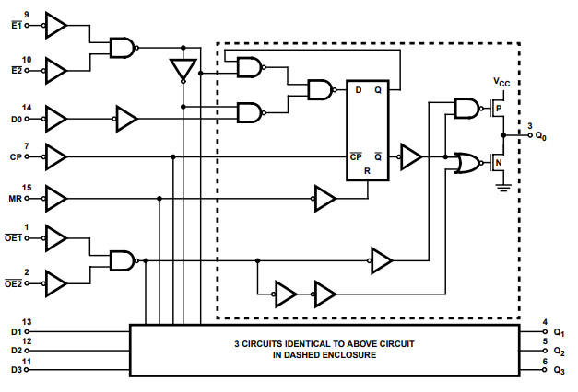
Lecture
SLIDE 4 / 10
Logic Micro-operations Definition
1
Logic micro-operations specify bit manipulation operations on registers
2
They operate on individual bits or groups of bits within a register
3
Common operations include AND, OR, XOR, and NOT for data processing
4
These operations are essential for masking, setting, and clearing specific bits
5
They form the basis for complex arithmetic and control logic execution
From Logic Gates to Registers: Exploring the 74HC173
Chandigarh University
4 / 10
Notes:
Logic micro-operations are the fundamental bit-level manipulations performed on register contents. They operate on individual bits to perform tasks like masking or setting specific flags. For example, an AND operation can clear specific bits while leaving others unchanged. These operations are the building blocks for all complex data processing in the CPU.

Slide 5
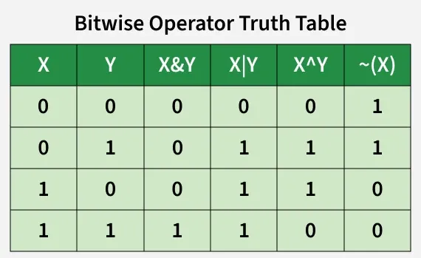
Lecture
SLIDE 5 / 10
Basic Logic Operations
GOVERNING EQUATION
Example: A = 1101, B = 1011, then A AND B = 1001
AND OPERATION
Result bit is 1 only if both input bits are 1
OR OPERATION
Result bit is 1 if at least one input bit is 1
XOR OPERATION
Result bit is 1 if input bits are different
NOT OPERATION
Inverts every bit in the source register operand
Source: media.geeksforgeeks.org
Chandigarh University
5 / 10
Notes:
Let's look at the four basic logic operations. The AND operation produces a 1 only when both inputs are 1. The OR operation yields 1 if either input is 1. The XOR operation is useful for toggling bits, while NOT simply inverts the data. Consider A = 1101 and B = 1011; their AND result is 1001, demonstrating how bits are selectively preserved.

Slide 6
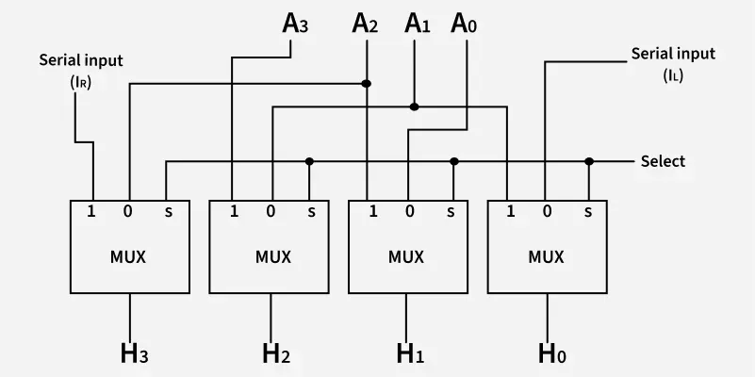
Lecture
SLIDE 6 / 10
Shift Micro-operations Overview
THREE TYPES EXIST
Logical, Circular, and Arithmetic shifts
• Shift operations move bits left or right within a register
• They are used for multiplication, division, and data alignment tasks
• Logical shifts fill empty positions with zeros
• Circular shifts rotate bits without losing information
Source: media.geeksforgeeks.org
Chandigarh University
6 / 10
Notes:
Shift micro-operations move bits within a register to the left or right. They are critical for multiplication and division operations as well as data alignment. There are three main types: logical, circular, and arithmetic. Logical shifts fill empty spots with zeros, while circular shifts rotate bits to preserve all data.

Slide 7
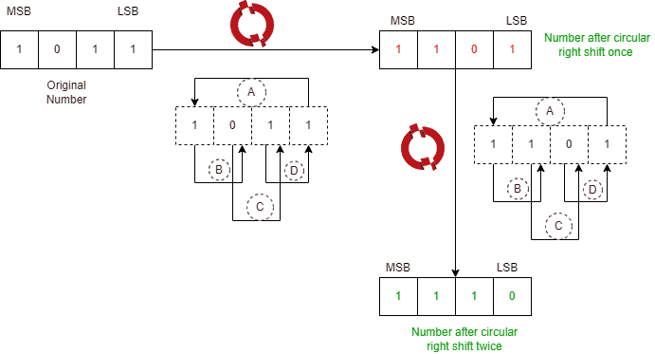
Lecture
SLIDE 7 / 10
Logical and Circular Shifts
GOVERNING EQUATION
Example: Register A = 11010100, SHL results in 10101000
1
Logical Shift Left (SHL): Shifts bits left, fills LSB with 0
2
Logical Shift Right (SHR): Shifts bits right, fills MSB with 0
3
Circular Shift Left (CRL): MSB moves to LSB position
4
Circular Shift Right (CRR): LSB moves to MSB position
Source: www.baeldung.com
Chandigarh University
7 / 10
Notes:
In a logical shift left, bits move left and the least significant bit becomes zero. A logical shift right moves bits right and fills the most significant bit with zero. Circular shifts are different; the bit shifted out re-enters at the opposite end. For instance, shifting 11010100 left logically results in 10101000, effectively doubling the value.

Slide 8
Lecture
SLIDE 8 / 10
Arithmetic Shift Operations
EXAMPLE
-12 (11110100) ASR 1 results in -6 (11111010)
• Arithmetic Shift Left (ASL): Same as logical shift left
• Arithmetic Shift Right (ASR): Preserves sign bit during right shift
• ASR is used for signed integer division by powers of two
• Sign bit remains unchanged to maintain number sign
Chandigarh University
8 / 10
Notes:
Arithmetic shift left is identical to logical shift left. However, arithmetic shift right preserves the sign bit to maintain the number's sign. This is essential for signed integer division by powers of two. For example, shifting -12 right arithmatically results in -6, keeping the negative sign intact while dividing the magnitude.

Slide 9
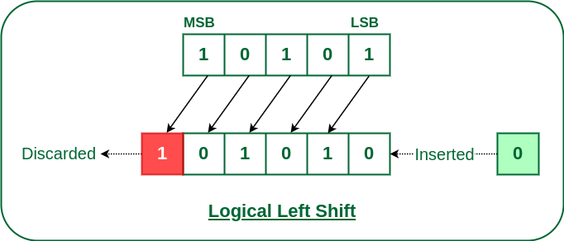
Lecture
SLIDE 9 / 10
Key Takeaways
1
Logic micro-operations manipulate individual bits using AND, OR, XOR, NOT
2
Shift operations move bits for multiplication, division, and alignment
3
Logical shifts fill with zeros, while circular shifts rotate bits
4
Arithmetic shifts preserve the sign bit for signed number operations
5
Understanding these operations is vital for analyzing register organization
Source: media.geeksforgeeks.org
Chandigarh University
9 / 10
Notes:
To summarize, logic micro-operations manipulate bits using AND, OR, XOR, and NOT. Shift operations move bits for multiplication, division, and alignment tasks. We distinguished between logical shifts that fill with zeros and circular shifts that rotate. Finally, arithmetic shifts preserve the sign bit, which is crucial for signed number operations.

Slide 10
Lecture
SLIDE 10 / 10
References
COMPUTER ORGANIZATION AND DESIGN
The Hardware/Software Interface — David A. Patterson, John L. Hennessy
COMPUTER ARCHITECTURE
A Quantitative Approach — John L. Hennessy, David A. Patterson
• Computer Organization and Architecture — William Stallings
• Computer System Architecture — M. Morris Mano & Rajib Mall
• Computer Organization — Carl Hamacher, Zvonko Vranesic, Safwat Zaky
Chandigarh University
10 / 10
Notes:
These five textbooks provide comprehensive coverage of the topics discussed today. William Stallings and M. Morris Mano offer excellent foundational explanations of register organization. The works by Hamacher and the duo of Hennessy and Patterson provide deeper insights into hardware-software interfaces and quantitative analysis. Please refer to these texts for further study.

